Slide 1







TIMETABLE PLANNER WEBSITE
AC4150E
-
152296
Low-fi Prototype (and more!)
From:
Group 3

Slide 2
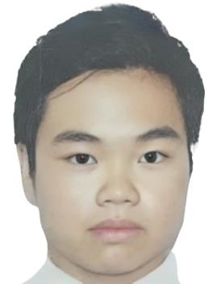





Nguyen Gia Bao
Nguyen Do Hoang Minh
Nguyen Huu Phong
20210099
ET-E16 – K66
20210591
ET-E16 – K66
20210668
ET-E16 – K66

Slide 3






Table of Contents!
Low-fi Prototype Construction
Problem & Solution
Task Flows
Sketching Explorations
Testing Methodology
Testing Results
Also included: Appendix
Selected Interface & Rationale
Discussion

Slide 4

01
Problem & Solution

Slide 5


Value Proposition
Effortless timetable planning tailored for HUST students.

Slide 6





Problem
Solution
HUST students face difficulties visualizing their timetables before course registration due to the lack of an official tool.
A user-friendly app that allows students to customize and visualize their timetables quickly, ensuring smooth course registration.
User Focus
HUST students.

Slide 7
02
Sketching Explorations

Slide 8
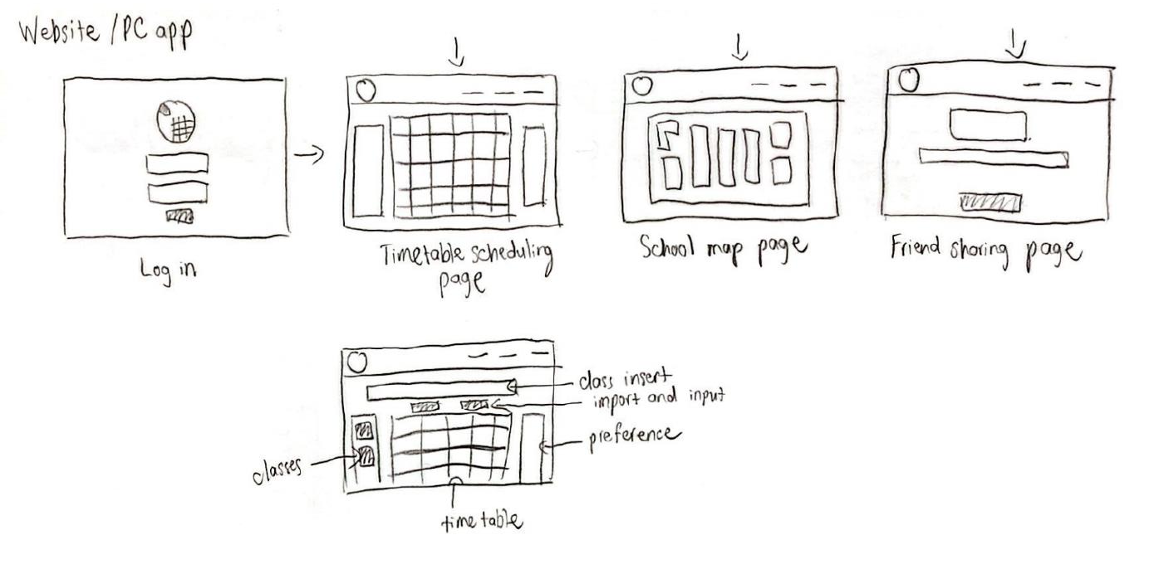

Concept 1: Website/PC App

Slide 9
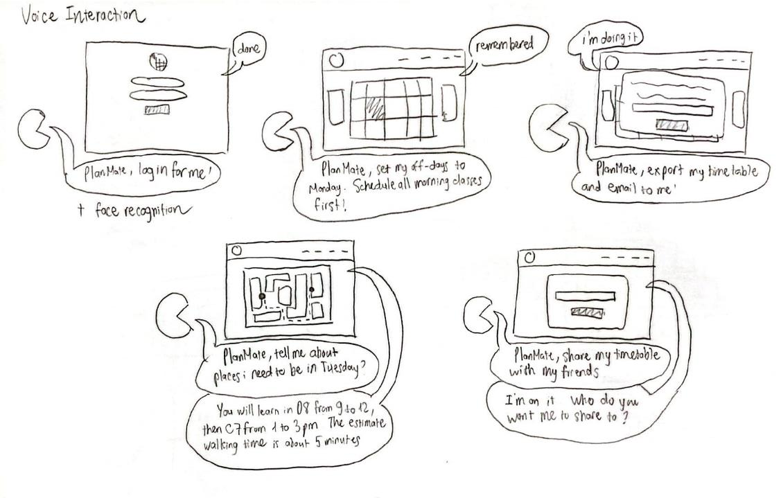
Concept 2: Voice Interaction

Slide 10
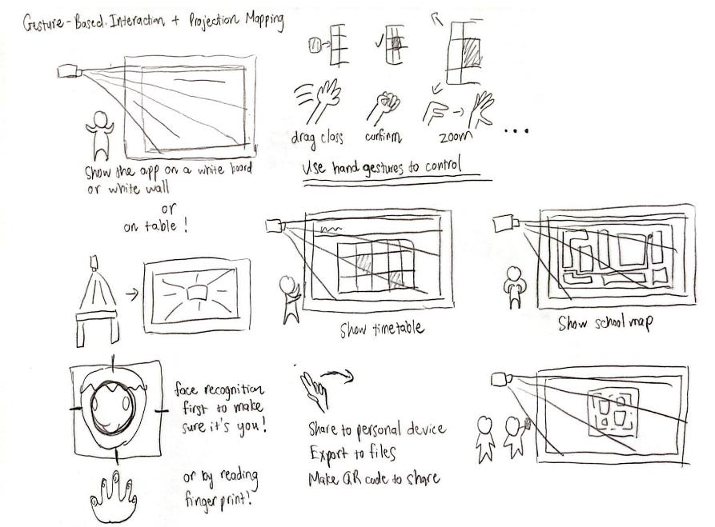
Concept 3: Gesture-Based Interaction +
Projection Mapping

Slide 11
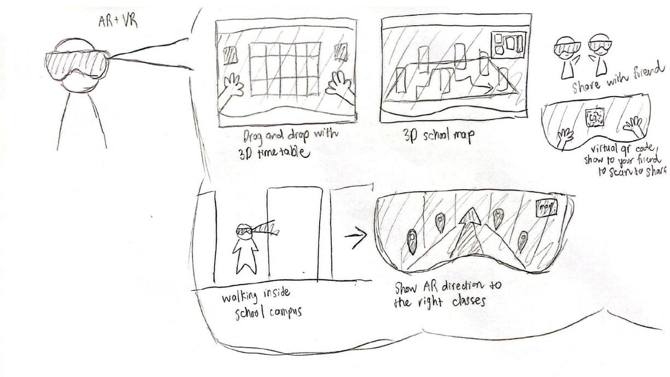
Concept 4: AR + VR Walkthrough

Slide 12
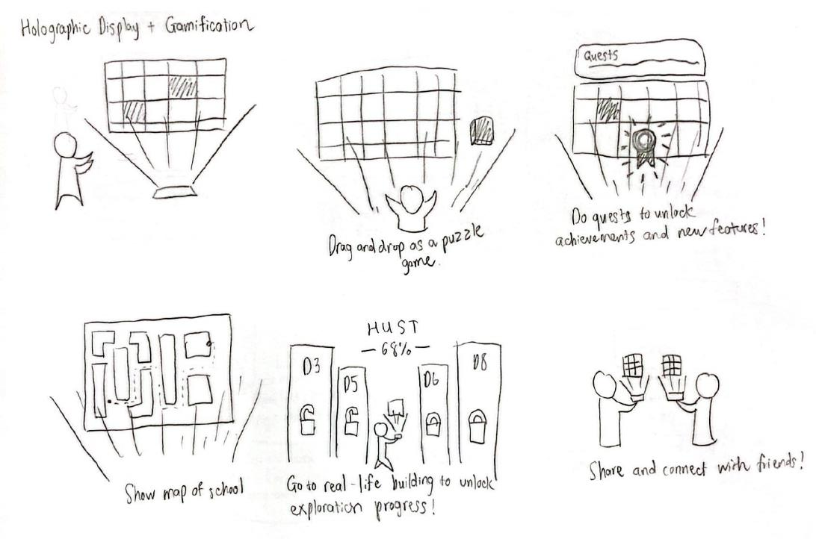
Concept 5: Hologram Display + Gamification

Slide 13
02
Sketching Explorations
Top 2 Diverse Realizations

Slide 14
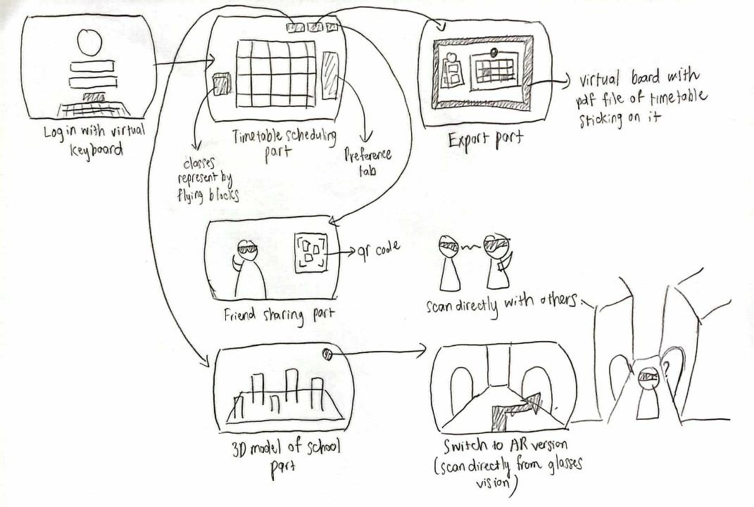
AR + VR Walkthrough

Slide 15

Pros
Cons
Immersive Experience: Enhances user engagement through interactive 3D visuals.
Intuitive Navigation: Helps students explore and plan using spatial interactions.
Innovative Appeal: Attracts tech-savvy users with cutting-edge features.
High Barriers to Access: Requires AR/VR-capable devices, limiting adoption.
Costly Development: Significant investment in hardware and 3D design.
Complex for New Users: Non-tech-savvy students may face challenges.

Slide 16
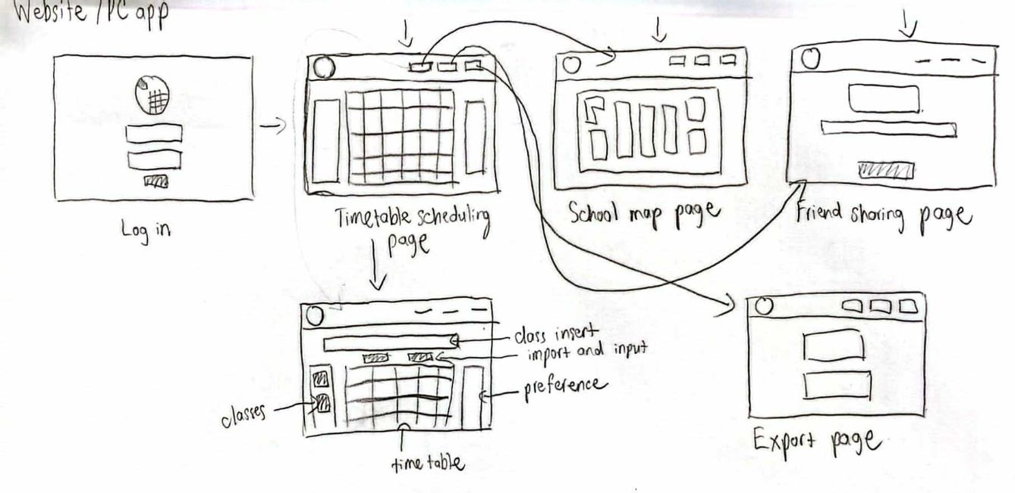
Website/PC App

Slide 17
Pros
Cons
Wide Accessibility: Works on any browser or device, no extra hardware needed.
User-Friendly Design: Familiar interface ensures ease of use for all students.
Cost-Effective: Lower development and maintenance expenses.
Lacks Immersion: Provides a functional but less engaging experience.
Risk of Overcrowding: Overloaded screens may confuse some users.
Limited Interactivity: Offers fewer innovative features compared to AR/VR.

Slide 18
03
Selected Interface & Rationale

Slide 19
Comparisons
Aspect | AR + VR | Website/PC App
User Engagement | High immersion, engaging interactivity. | Moderate engagement, practical interface.
Ease of Access | Device-dependent, costly setup. | Accessible to all students.
Cost and Development | High development and hardware costs. | Moderate costs with easier maintenance.
Learning Curve | Steep for some users; tech-heavy. | Easy to use; familiar interface.
Scalability | Hard to scale without specialized devices. | Highly scalable with minimal restrictions.

Slide 20
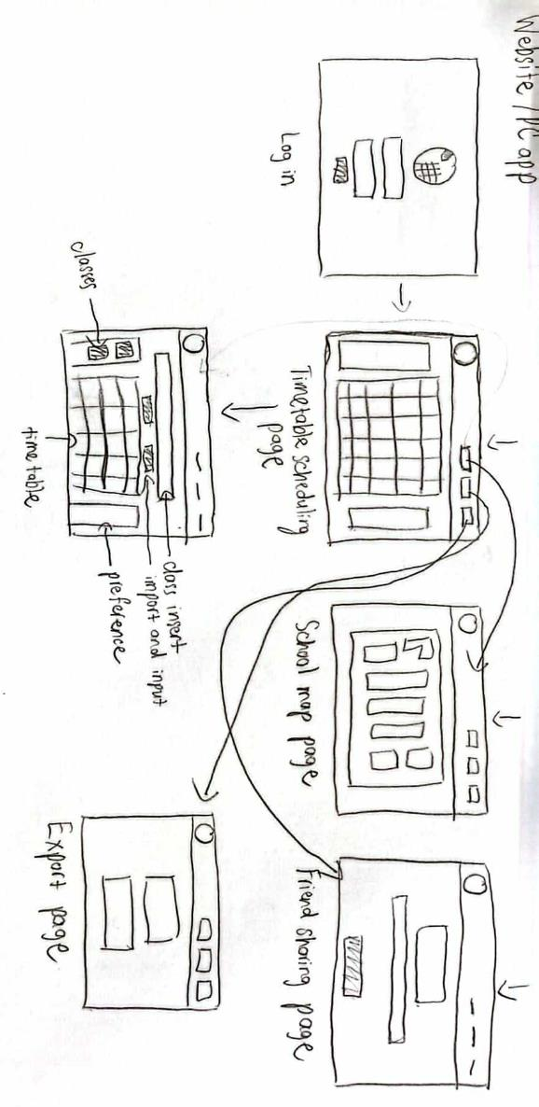




Selected Interface

Slide 21
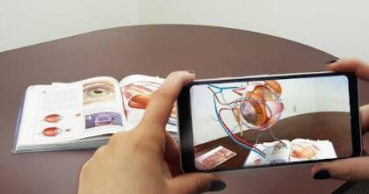

Rationale
Immersive and engaging but requires expensive hardware.
High development costs and steep learning curve for some users.
Less practical for HUST students who prioritize simplicity and accessibility.
Why not choosing AR + VR?

Slide 22

04
Low-fi Prototype Construction

Slide 23
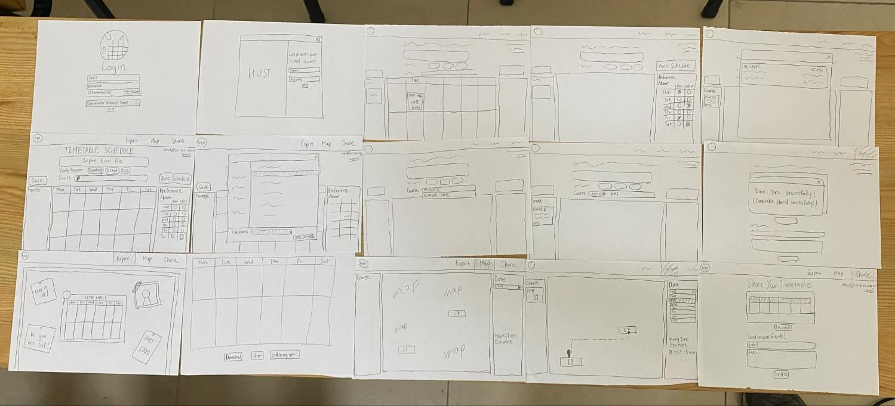
Low-fi Prototype

Slide 24
Low-fi Prototype

Slide 25
Low-fi Prototype
Better Version

Slide 26
05
Task Flows

Slide 27


3 Task Flows
Simple Task
Moderate Task
Complex Task
Export the personalized
timetable to a PDF
View the campus map
with class locations
Automatically generate and
view a personalized
timetable

Slide 28
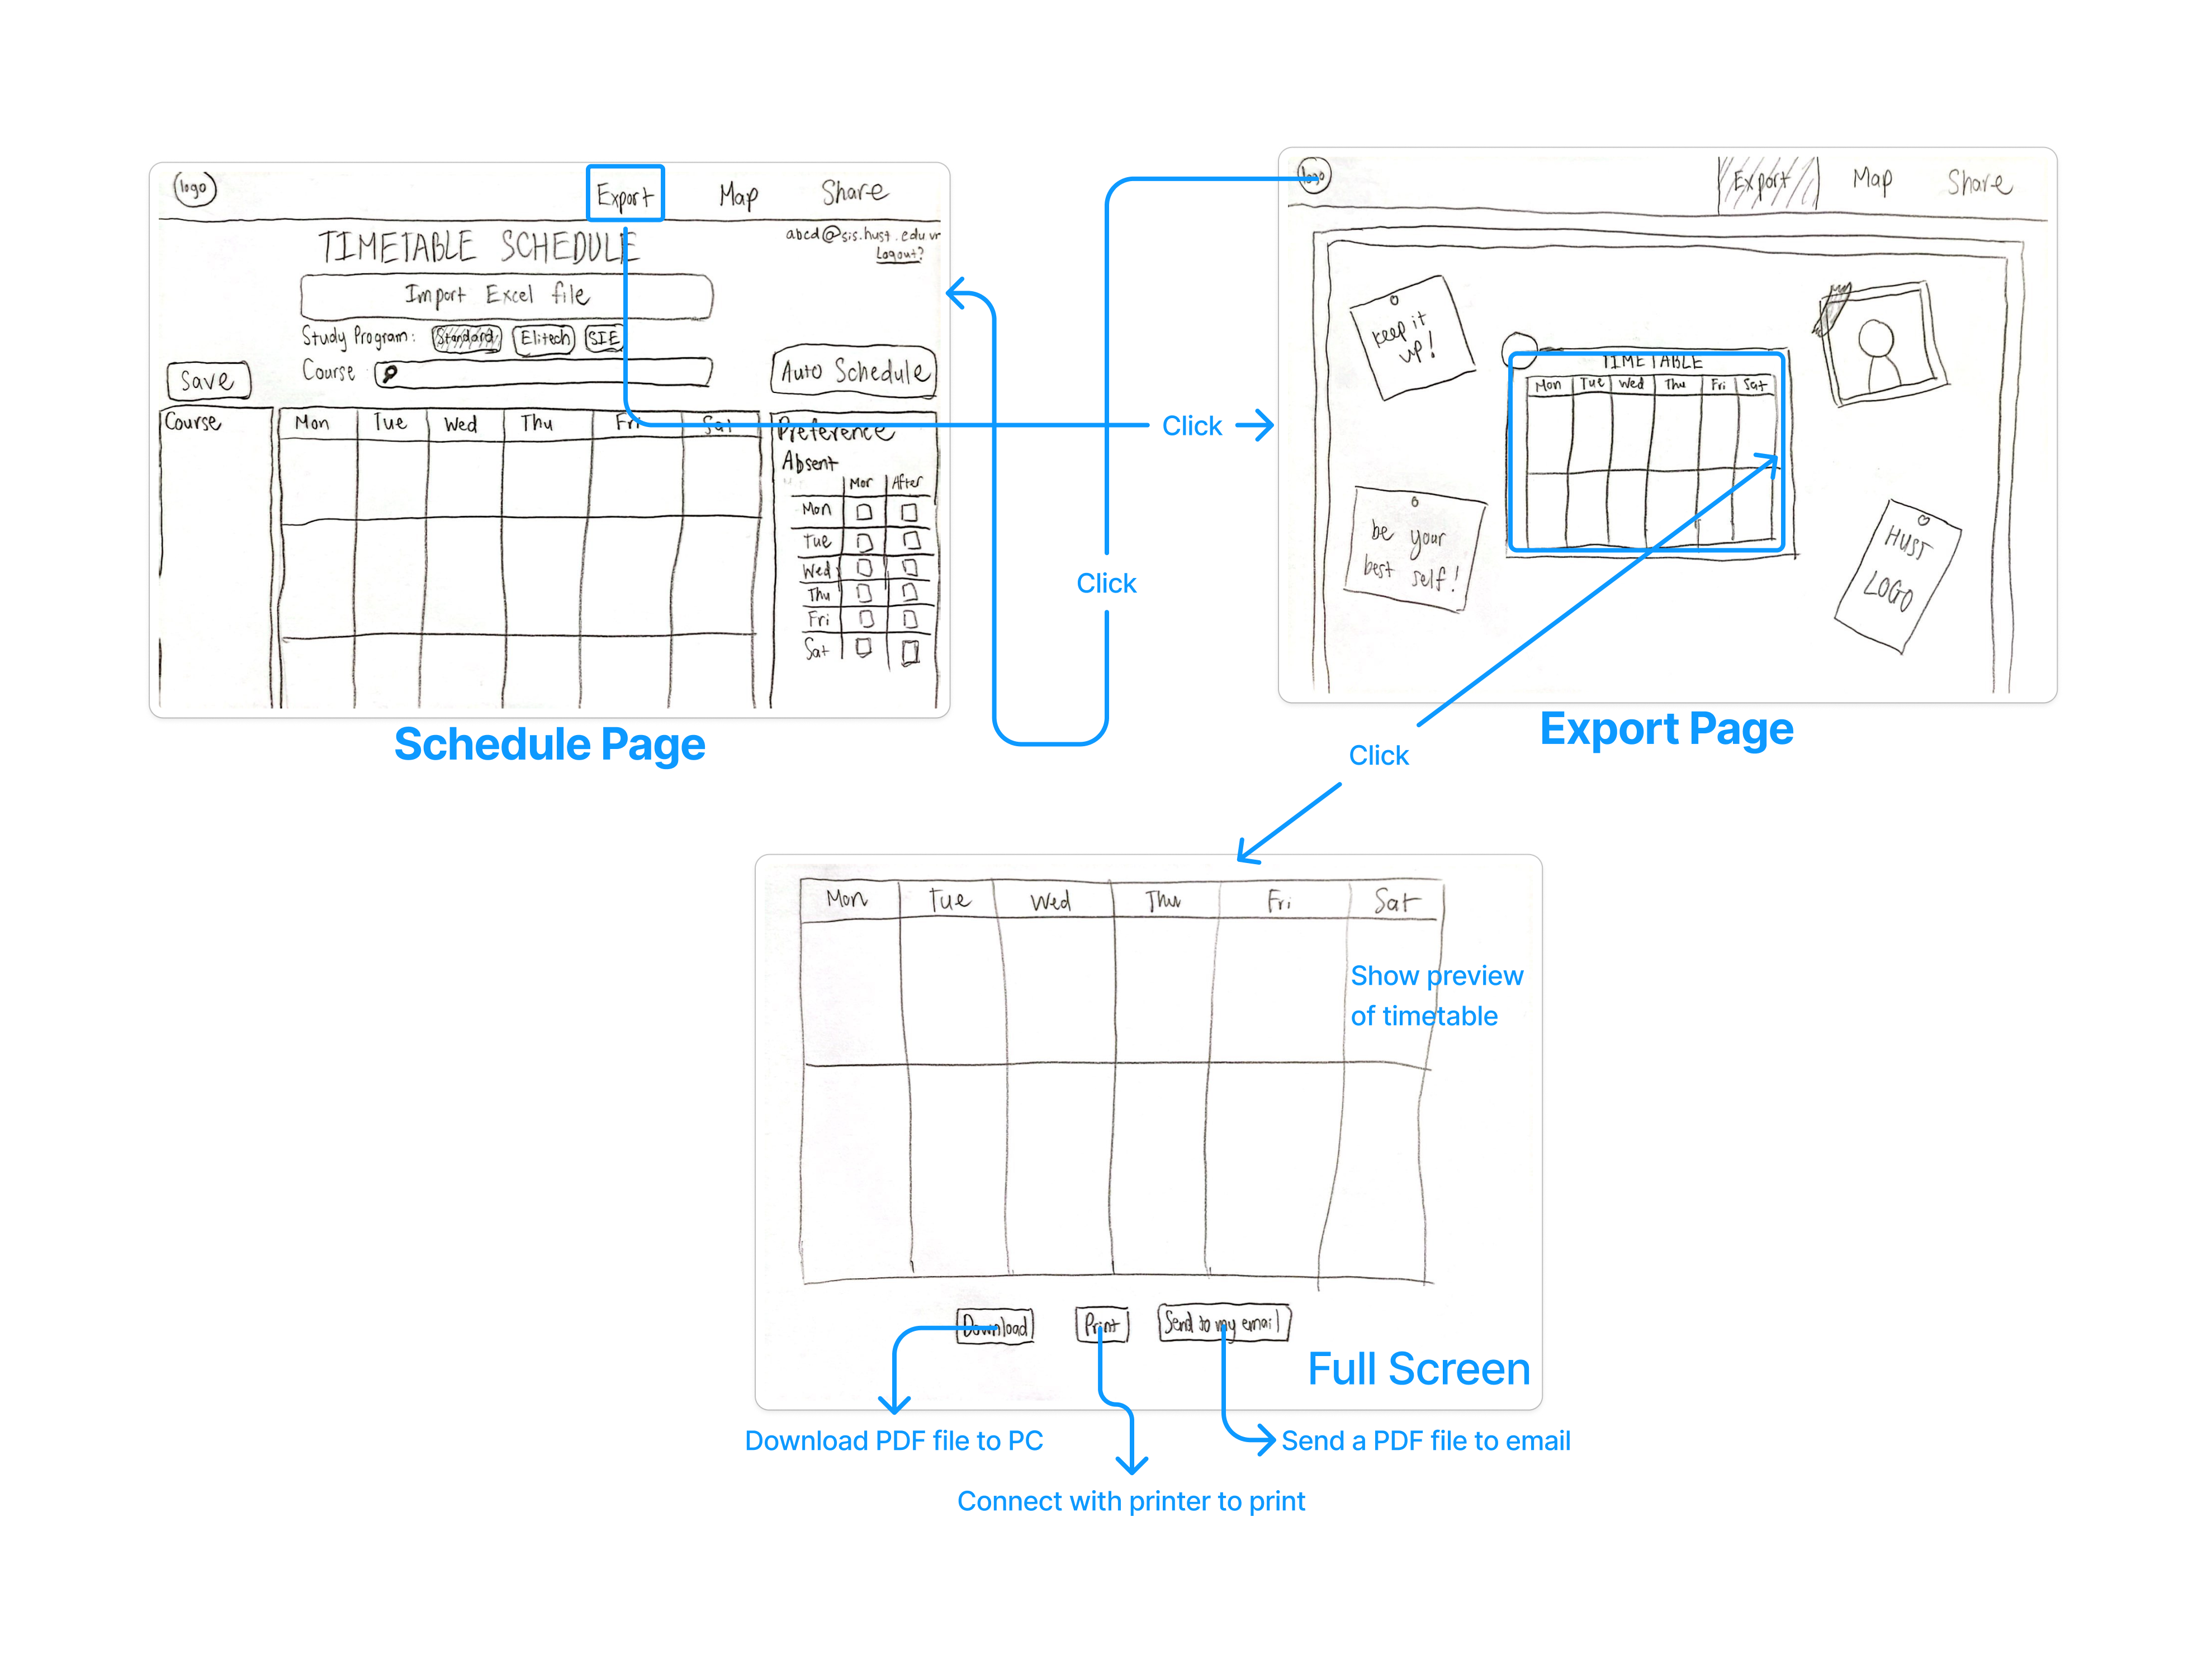
Simple Task Flow
Export the personalized
timetable to a PDF

Slide 29
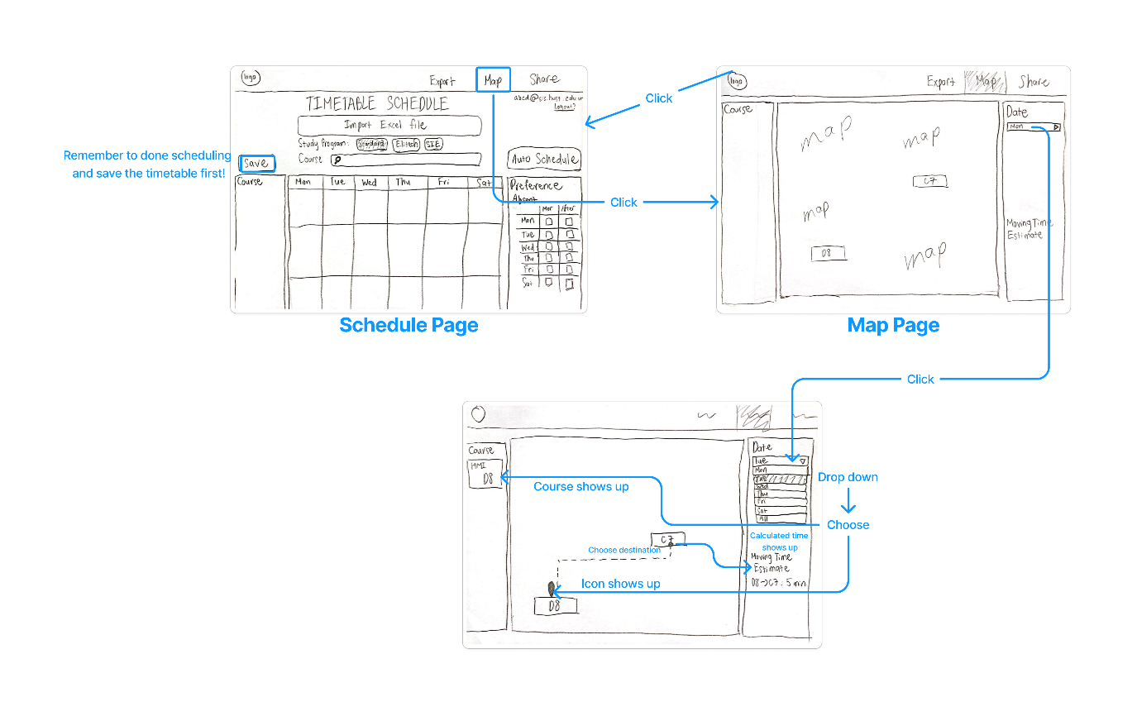
Moderate Task Flow
View the campus map
with class locations

Slide 30
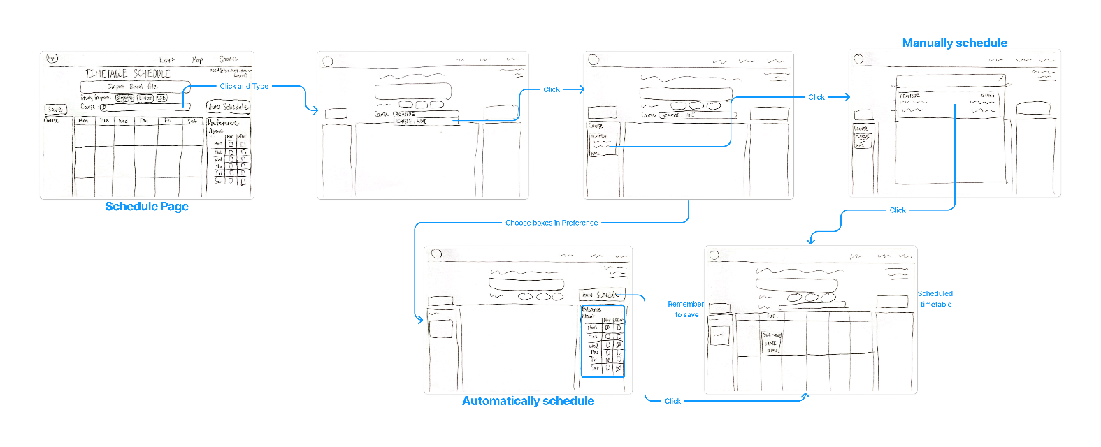
Complex Task Flow
Automatically generate and
view a personalized
timetable

Slide 31
06
Testing Methodology

Slide 32



Duy
My
Nhi
(20)
SOICT, HUST, Hanoi
(21)
Banking Academy, Hanoi
(21)
University of Exeter, England

Slide 33
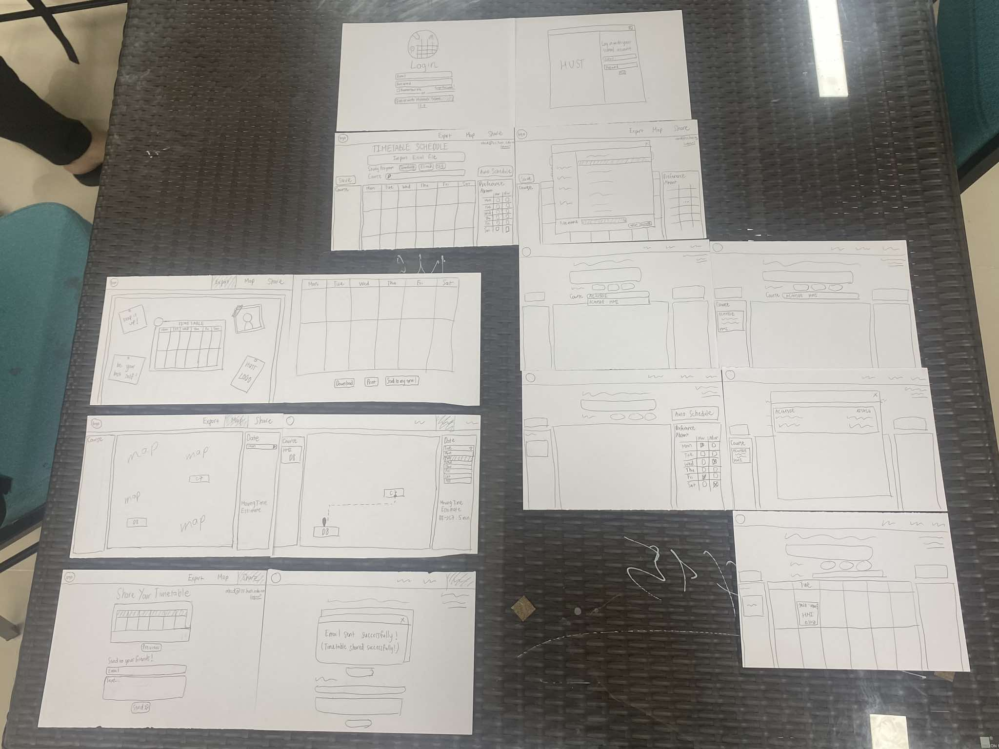
Environment & Apparatus
We created a paper prototype and simulated user interactions manually.
The prototypes were arranged on a table, and participants interacted with them following our script.

Slide 34
Nguyen Gia Bao
Nguyen Do Hoang Minh
Nguyen Huu Phong
Roles
Observer/
Note-taker
Facilitator/ Note-taker
Facilitator/ Computer

Slide 35
Procedure & Progress
Introduction
Welcome participant and explain purpose (testing PlanMate prototype).
Emphasize testing the prototype, not their skills.
Obtain consent for participation and note-taking.
Arrange paper prototype elements logically.
Explain roles (facilitator, computer, observer).
Briefly outline the 3 tasks.
Set Up

Slide 36
Procedure & Progress
Task Execution
Task 1: Export timetable to PDF.
Task 2: View campus map with class locations.
Task 3: Generate and view personalized timetable.
Observe user behavior and note challenges.
Ask about likes, dislikes, and moments of confusion.
Collect suggestions for improvement.
Thank participant and explain how feedback will help refine PlanMate.
Feedback
Conclusion

Slide 37

Usability Goals and Metrics
1) Efficiency
Goal: Participants should complete tasks quickly and without unnecessary steps.
Key Measurement: Time taken to complete each task (measured in minutes and seconds).
2) Clarity and Intuitiveness
Goal: The interface should be easy to understand and navigate.
Key Measurement:
Number of errors (e.g., choosing the wrong feature or being unsure of what to do).
Participant feedback on clarity (e.g., a 1-5 scale on how intuitive they found the prototype).

Slide 38
07
Testing Results

Slide 39
Process Data
All Participants
Found the concept of the app useful and relevant.
Liked the idea of the campus map.
Appreciated the idea of a streamlined and clean interface.
Found the ‘Save’ button difficult to locate.
Felt the app would benefit from more consistent navigation features, such as a ‘Home’ tab instead of clicking the logo.
Loved the idea of ‘Friend Sharing’ function.

Slide 40
Process Data
Two Participants
Mistakenly clicked the ‘Share’ button instead of the ‘Export’ button.
Commented on the placement of critical buttons (like ‘Export’ and ‘Save’).
Mentioned that the overall task flow was simple to follow once they figured out the necessary actions.
Suggested that the ‘Download’ and related button should be right under the timetable instead.
Thought the bulletin-board-theme ‘Export’ was cool and unique.

Slide 41
Process Data
One Participant
Didn’t see the ‘Preference’ part to use.
Accidentally manually scheduled timetable instead of using auto schedule function.
Got confused at the ‘List of classes’ window.
Got confused at the bulletin-board-theme ‘Export’ page.
Didn’t know how to use the ‘Moving Time Estimate’ function.

Slide 42
Process Data
Task 1: Export Timetable to PDF
Common Feedback:
Strength: The export function is straightforward once users locate the correct button.
Issues:
Two participants misclicked the ‘Share’ button at least once, confusing it with Export.
The ‘Export’ button was described as hard to find and not prominent enough.
-> Mostly functional but lacks visibility for key buttons.

Slide 43
Process Data
Task 2: View Campus Map with Class Locations
Common Feedback:
Strength: The map feature has strong potential and was positively received conceptually. Participants liked the idea of estimating travel time between classes.
Issues:
Navigation between tabs was a little bit hard to do.
The travel time estimation lacked clarity—users were unsure where to start or select endpoints.
-> Conceptually strong but needs better guidance for user actions.

Slide 44
Process Data
Task 3: Generate and View Personalized Timetable
Common Feedback:
Strength: Participants found the concept of auto-generating a timetable appealing and thought it would save significant time during course registration.
Issues:
Preferences setup was confusing, with a user misinterpreting it as manual selection instead of automated planning.
The ‘Save’ button was overlooked by all participants due to its placement and lack of visibility.
-> Valuable feature but struggles with unclear preferences and save functionality.

Slide 45
08
Discussion

Slide 46
Bottom-line Data
Usability Goals Achievement Summary
Efficiency (Score: 3.5/5):
Achieved: Basic tasks were completed, but not efficiently. Misclicks and navigation confusion slowed down completion times.
Not Achieved: Several users needed to backtrack or retrace steps, which led to delays across all tasks.
Clarity and Intuitiveness (Score: 3/5):
Partially Achieved: The app had potential, but users required significant trial-and-error to complete tasks. Errors due to unclear button placements, and task confusion were common.
Not Fully Achieved: The prototype's lack of step-by-step instructions and misplacement of buttons significantly hindered task clarity.

Slide 47

Bottom-line Data
Implications
Button Placement & Labeling: Misclicks show the need for better visual hierarchy and clear labeling to reduce errors.
Navigation Improvements: Adding a ‘Home’ tab or breadcrumb trails can simplify task transitions and enhance user flow.
Guidance for Complex Features: Tasks like setting preferences and using the map require tooltips or instructions to guide users, especially first-timers.

Slide 48

Bottom-line Data
Changes
Button Redesign: Position critical buttons prominently and use consistent design patterns. Maybe add confirmation messages after actions.
Enhanced Navigation: Add a ‘Home’ tab for easy access to the main page and breadcrumbs to show user location within the app.
Feature Guidance: Provide tooltips or tutorials for the ‘Preferences’ setup and ‘Travel Time Estimation’. Improve map annotations with clearer start/end points.

Slide 49
Bottom-line Data
What’s Testing Couldn’t Reveal
Aesthetic Appeal: The lack of color and final design elements means user opinions on the visual design were not assessed.
Long-Term Usability: Testing was done on first-time use; how users adapt or perform over time was not evaluated.
Performance Under Load: The prototype didn’t simulate real-world usage, so performance and scalability remain untested.
Edge Cases: Scenarios like conflicting preferences or incomplete timetable files were not fully explored.

Slide 50

TIMETABLE PLANNER WEBSITE
Thanks
Listening!
AC4150E
-
152296
For
Low-fi Prototype (and more!)
From:
Group 3

Slide 51
TIMETABLE PLANNER WEBSITE
Thanks
Listening!
APPENDIX
AC4150E
-
152296
For
Low-fi Prototype (and more!)
From:
Group 3

Slide 52
AR + VR Walkthrough
Pros
Immersive Experience: Users can interact with the timetable and map in a more engaging and realistic way.
Intuitive Interaction: AR/VR offers natural ways to manipulate objects (e.g., drag and drop or gesture control) that could simplify task completion.
Multi-Tasking Capability: With AR, users can view multiple layers of information, such as timetable data and campus map, at once.
Personalized Environment: VR creates a custom, personal space where users can feel more connected to the app and their tasks.
Innovative Appeal: VR and AR are innovative, which could attract tech-savvy users and differentiate the app in the market.
Visualized Campus Map: AR can superimpose the campus map directly into the user's environment, allowing for real-time, contextual navigation.
Potential for Gamification: Can integrate game-like elements, making the process of viewing timetables or navigating campus more enjoyable.
Reduced Cognitive Load: The immersive nature of AR/VR can help reduce cognitive load by presenting visual information in a spatial context, making it easier to understand.
Engaging Feedback: Provides haptic, auditory, and visual feedback, making interactions more engaging and satisfying.

Slide 53
AR + VR Walkthrough
Cons
High Development Costs: Developing AR/VR interfaces requires specialized technology and resources, which can be costly.
Hardware Requirements: Users need access to AR glasses, VR headsets, or compatible smartphones, which limits accessibility.
Learning Curve: Users unfamiliar with AR/VR may face a steep learning curve to understand how to interact with the system.
Complexity in Design: The interface needs to be designed for a 3D environment, which can be difficult and time-consuming.
Limited by Space and Movement: Users may feel constrained by the physical space required for AR/VR, especially in public or crowded areas.
Potential Motion Sickness: VR systems can cause motion sickness in some users, which limits prolonged use.
Accessibility Issues: Users with physical or visual impairments may struggle with AR/VR systems.
Energy Consumption: VR/AR systems, especially on mobile devices, consume a significant amount of battery power.
Overwhelming for Some Users: Immersion can be overwhelming for users who prefer simpler, less immersive experiences.
Lack of Final Design: Difficult to judge aesthetic appeal as VR/AR prototypes often lack detailed design elements (e.g., colors, textures).

Slide 54
Website/PC App
Pros
Accessibility: Can be used on any standard device, making it more accessible to a broader audience.
Familiarity: Users are accustomed to interacting with websites and PC apps, leading to faster adoption and fewer misunderstandings.
Easy to Update: Websites and PC apps can be updated easily and frequently without requiring users to install new versions.
Device Independence: Available on various devices (desktop, laptop, tablet, and mobile browser), offering flexibility in use.
Cost-Effective: Developing a website/PC app is typically less expensive than creating AR/VR experiences.
No Special Hardware Requirements: Users only need a basic computer or mobile device, making it highly accessible.
Scalability: Web and PC apps are more scalable, allowing for expansion of features or integration with other systems more easily.
Easy Navigation: Traditional 2D UI design is easier to navigate and use for most users, providing a familiar environment.
Consistent User Experience: The experience is consistent across devices, and users don't need to worry about VR or AR hardware compatibility.
More Control Over Interface Design: Web/PC apps allow for fine control over the design and layout, ensuring a clean and user-friendly interface.

Slide 55
Website/PC App
Cons
Limited Interactivity: Compared to AR/VR, websites and PC apps are less interactive and immersive.
Non-Immersive: The lack of immersion may make the user experience feel less engaging, especially for tech-savvy users.
Requires Internet Connection: Websites rely on internet connectivity, which can be a limitation for users with unstable connections.
Smaller Engagement: Users may not feel as invested or engaged as they would with an immersive VR/AR experience.
Less Innovative: While functional, websites and PC apps are generally seen as less innovative or exciting compared to AR/VR alternatives.
Limited Visual Appeal: Traditional design may feel flat or outdated compared to the dynamic, 3D nature of AR/VR.
Dependence on Screen Size: Web/PC apps require users to interact with them via a screen, which may not offer the same level of contextual interaction as AR.
Not Always Mobile-Optimized: Websites, especially those not responsive, may not work as effectively on mobile devices, limiting usability for mobile users.
Limited User Feedback: Unlike AR/VR, there’s less tactile or immersive feedback from interactions with a screen.
Navigation Issues for New Users: New users might struggle with understanding the layout or missing some features, leading to confusion or frustration.

Slide 56
Low-fi Prototype
Better Version

Slide 57
Script
Take a look!

Slide 58
Time Taken to Finish Each Tasks
 | Duy | My | Nhi
Task 1 | 47 s | 1 min | 30 s
Task 2 | 2 min 25 s | 3 min | 2 min 20 s
Task 3 | 1 min 36 s | 1 min 40 s | 2 min 10 s

Slide 59
Efficiency Scores
 | Duy | My | Nhi
Task 1 | 3 | 3 | 4
Task 2 | 4 | 4 | 3.5
Task 3 | 3.5 | 3.5 | 3
Clarity and Intuitiveness Scores
 | Duy | My | Nhi
Task 1 | 3.5 | 4 | 3
Task 2 | 3 | 2.5 | 3
Task 3 | 2.5 | 2.5 | 3

Slide 60
Critical Incident Log - Duy
Incident | Description | Severity (0-4)
1. Save Button Location | Found the ‘Save’ button difficult to locate. | 3
2. Navigation Consistency | Felt the app would benefit from more consistent navigation features, such as a ‘Home’ tab instead of clicking the logo. | 2
3. Export Button Misclick | Mistakenly clicked the ‘Share’ button instead of the ‘Export’ button. | 3
4. Task Flow | Commented that the overall task flow was simple to follow once they figured out the necessary actions. | 1
5. Download Button Placement | Suggested that the ‘Download’ and related buttons should be right under the timetable instead. | 2
6. Friend Sharing Function | Loved the idea of the ‘Friend Sharing’ function. | 0

Slide 61
Critical Incident Log - My
Incident | Description | Severity (0-4)
1. Preference Section | Didn’t see the ‘Preference’ part to use. | 4
2. Navigation Consistency | Felt the app would benefit from more consistent navigation features, such as a ‘Home’ tab instead of clicking the logo. | 2
3. Class List Confusion | Got confused at the ‘List of classes’ window. | 3
4. Task Flow | Commented that the overall task flow was simple to follow once they figured out the necessary actions. | 1
5. Moving Time Estimate | Didn’t know how to use the ‘Moving Time Estimate’ function. | 3
6. Export Page | Thought the bulletin-board-theme ‘Export’ was cool and unique. | 0

Slide 62
Critical Incident Log - Nhi
Incident | Description | Severity (0-4)
1. Save Button Location | Found the ‘Save’ button difficult to locate. | 3
2. Manual Scheduling | Accidentally manually scheduled timetable instead of using the auto-schedule function. | 3
3. Export Button Misclick | Mistakenly clicked the ‘Share’ button instead of the ‘Export’ button. | 3
4. Export Page Confusion | Got confused at the bulletin-board-theme ‘Export’ page. | 2
5. Download Button Placement | Suggested that the ‘Download’ and related buttons should be right under the timetable instead. | 2
6. Navigation Consistency | Felt the app would benefit from more consistent navigation features, such as a ‘Home’ tab instead of clicking the logo. | 2

